Slide 1
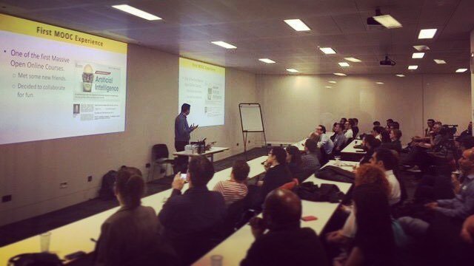
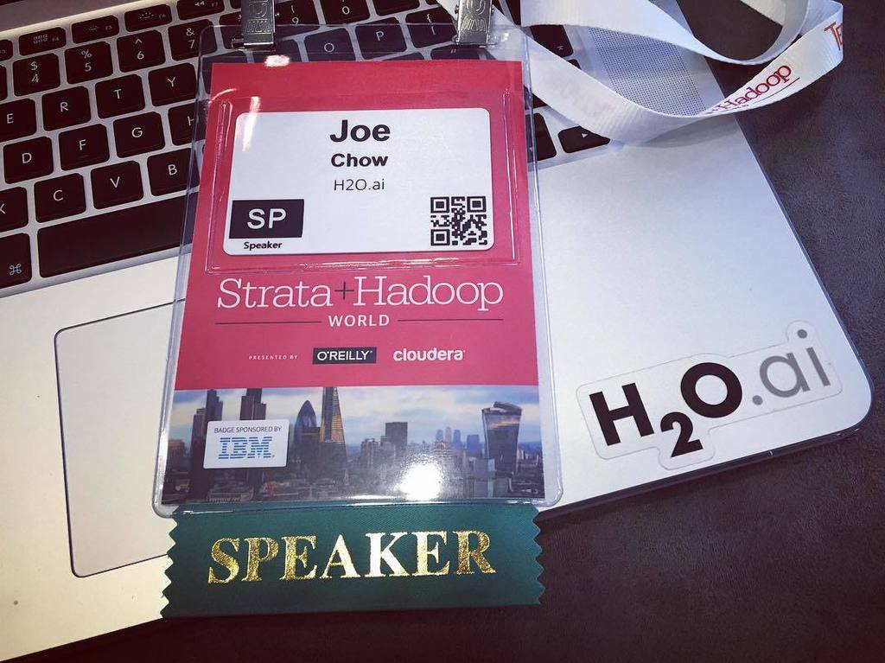
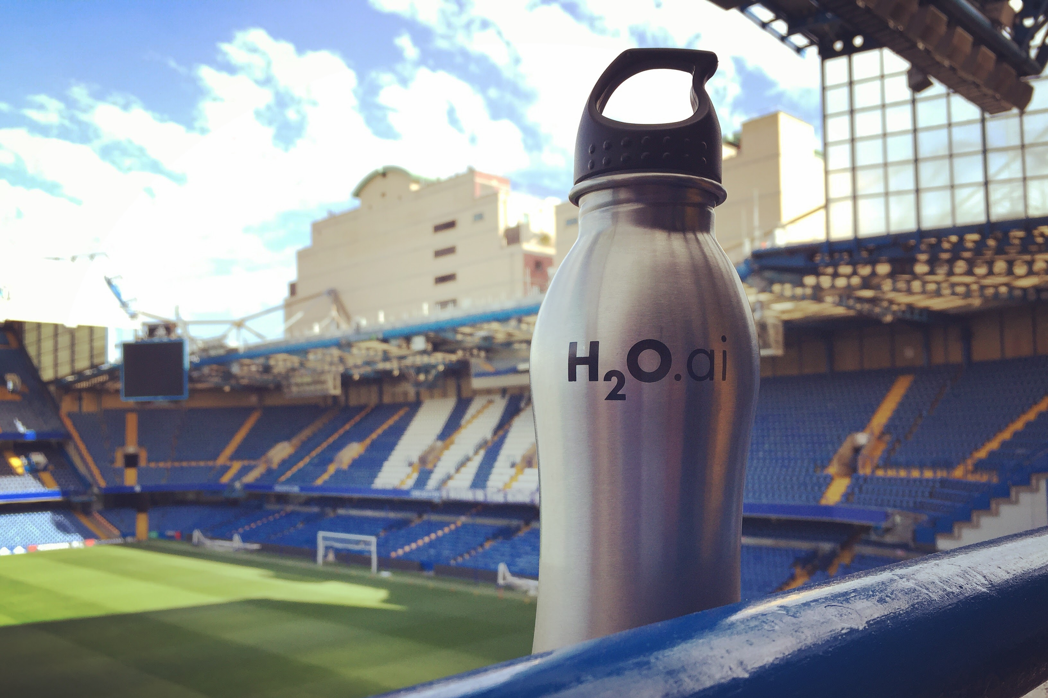
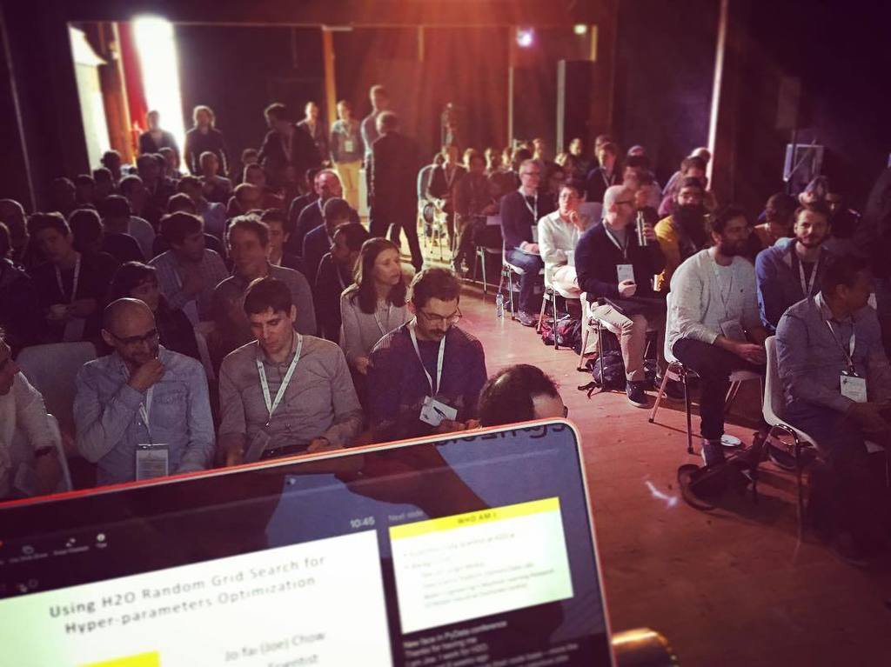
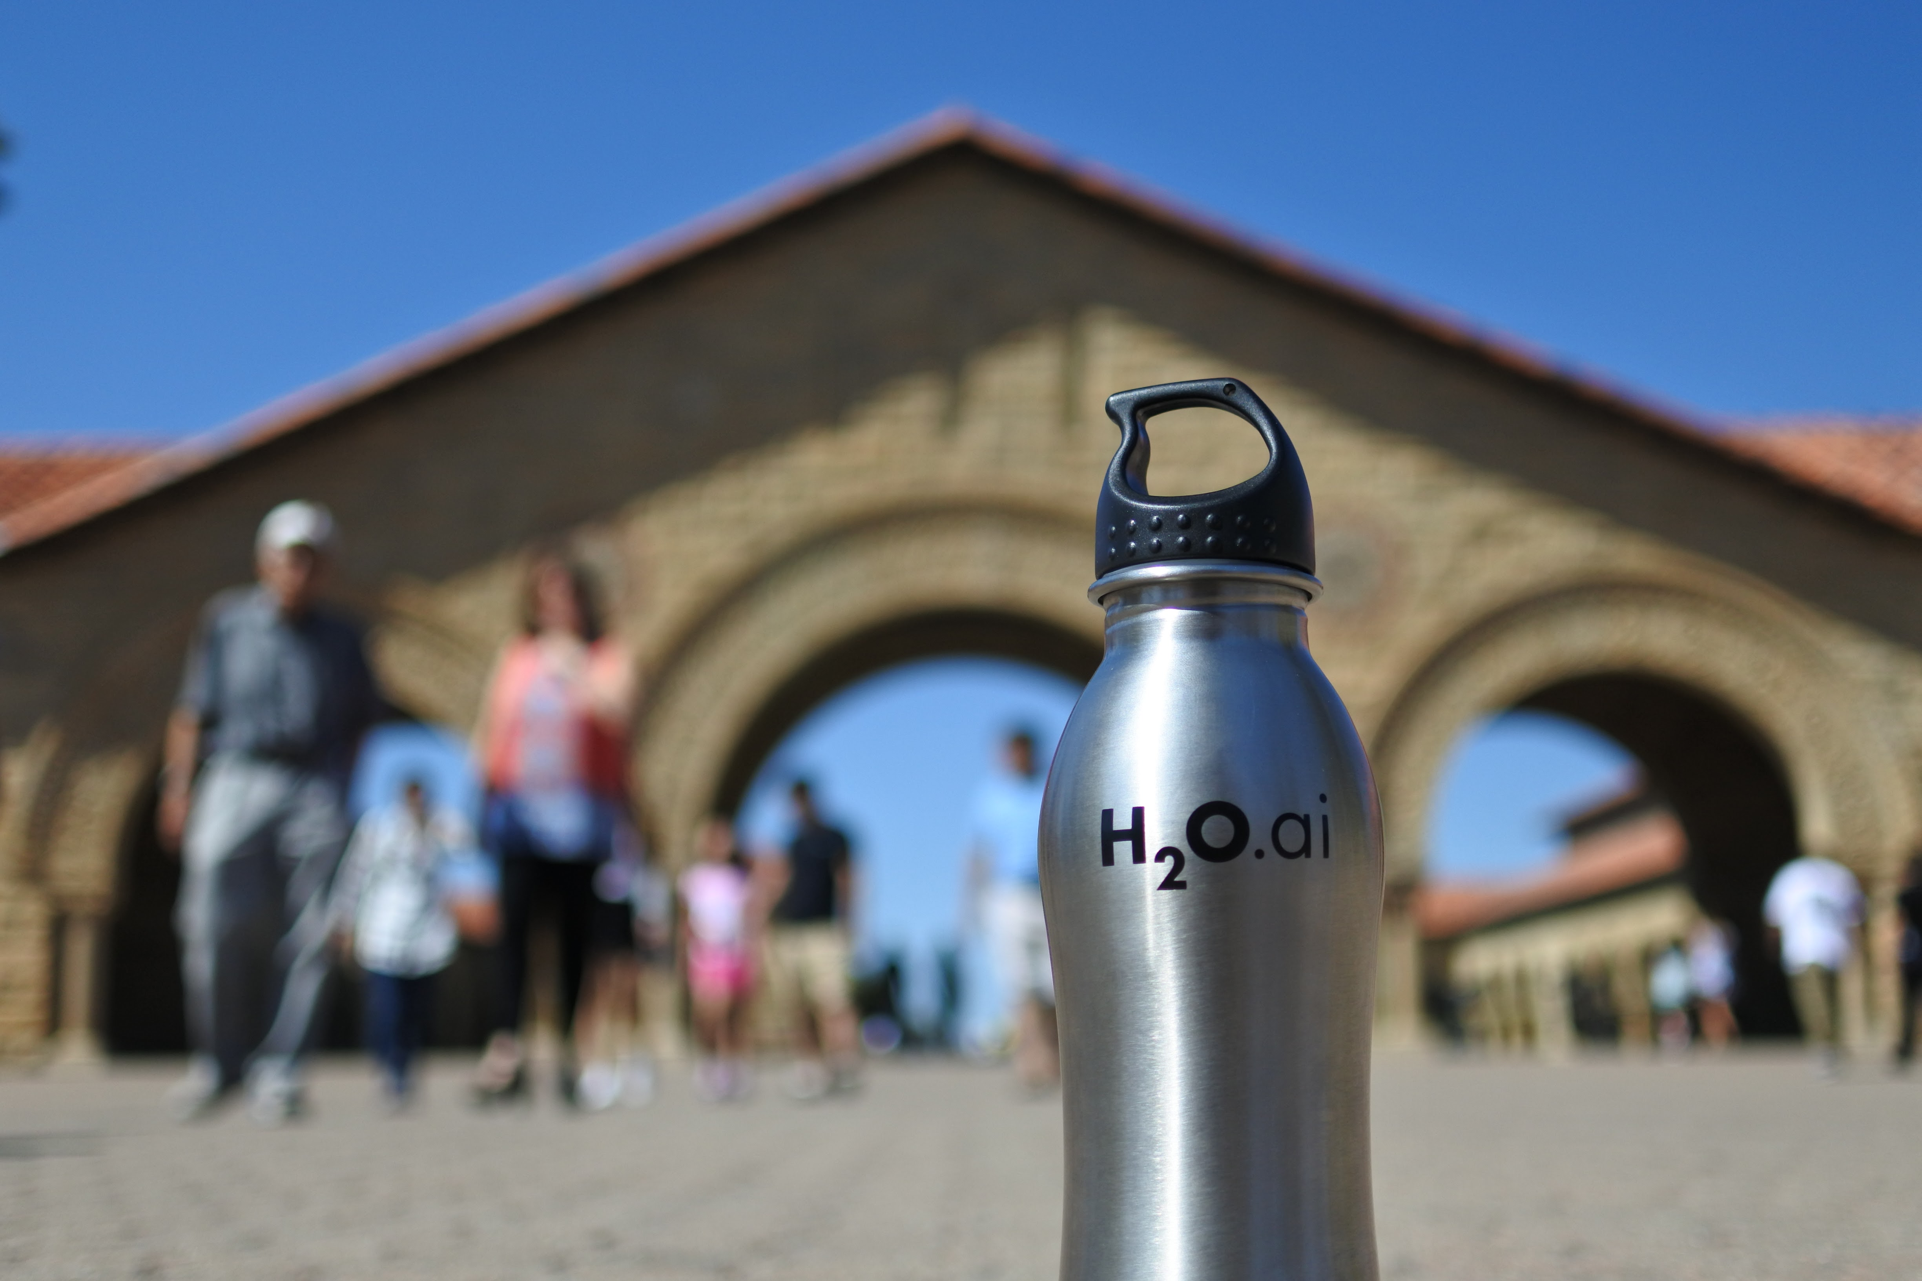
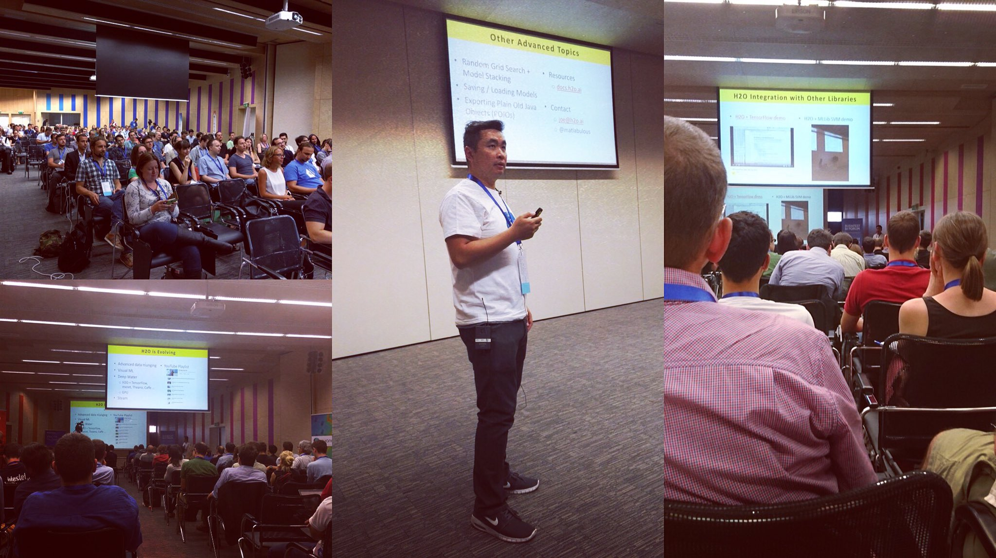
H2O Around the World
London Kaggle Meetup
Strata Hadoop
Chelsea Football Club
PyData
Amsterdam
useR! 2016
Stanford
satRdays
Budapest

Slide 2
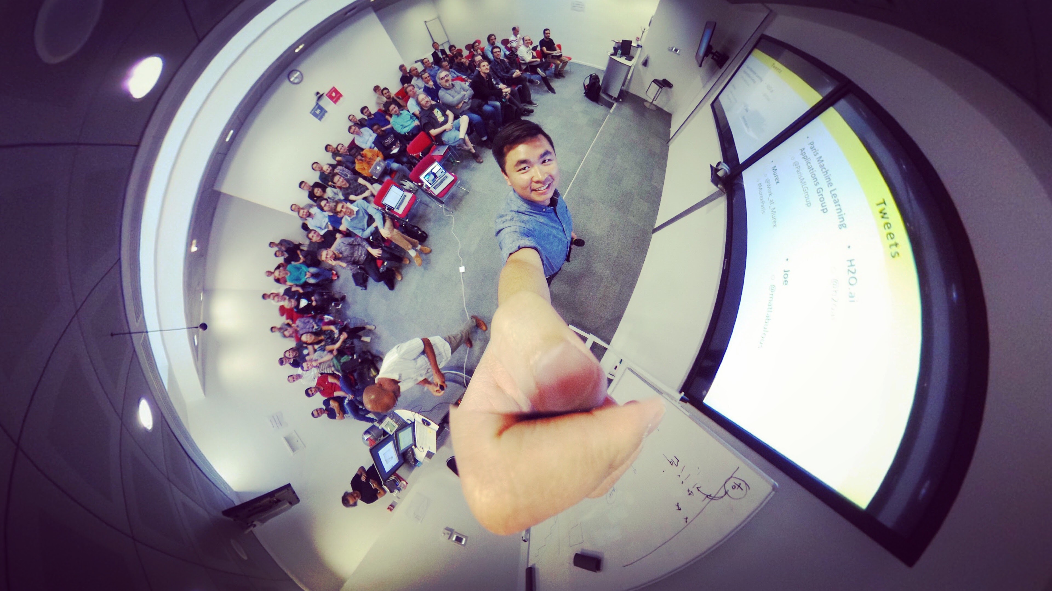
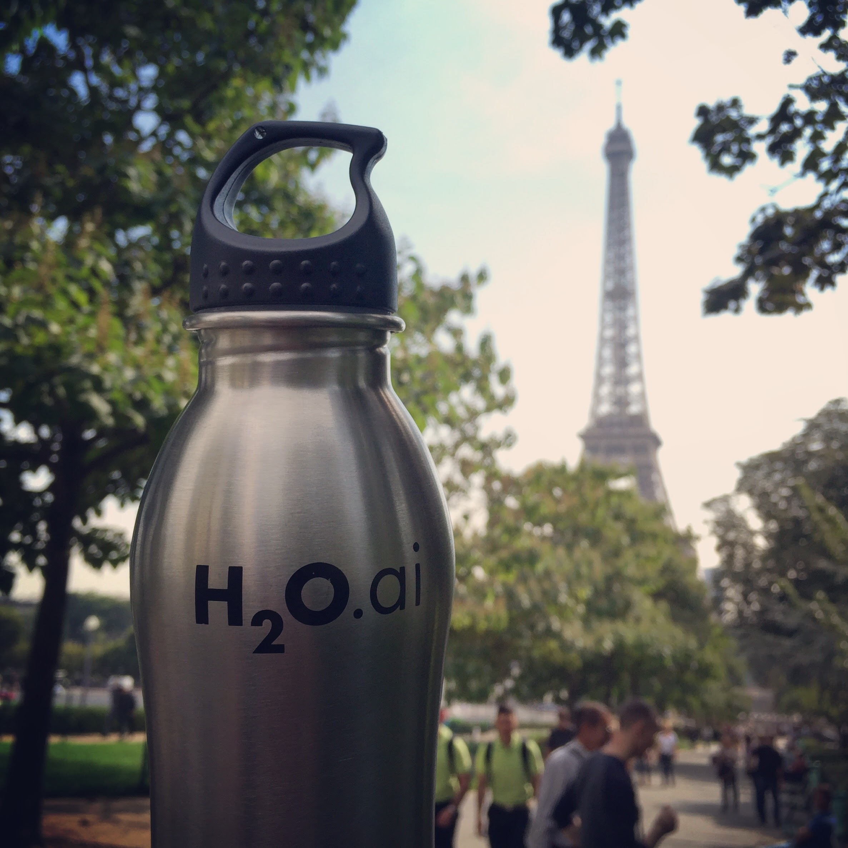
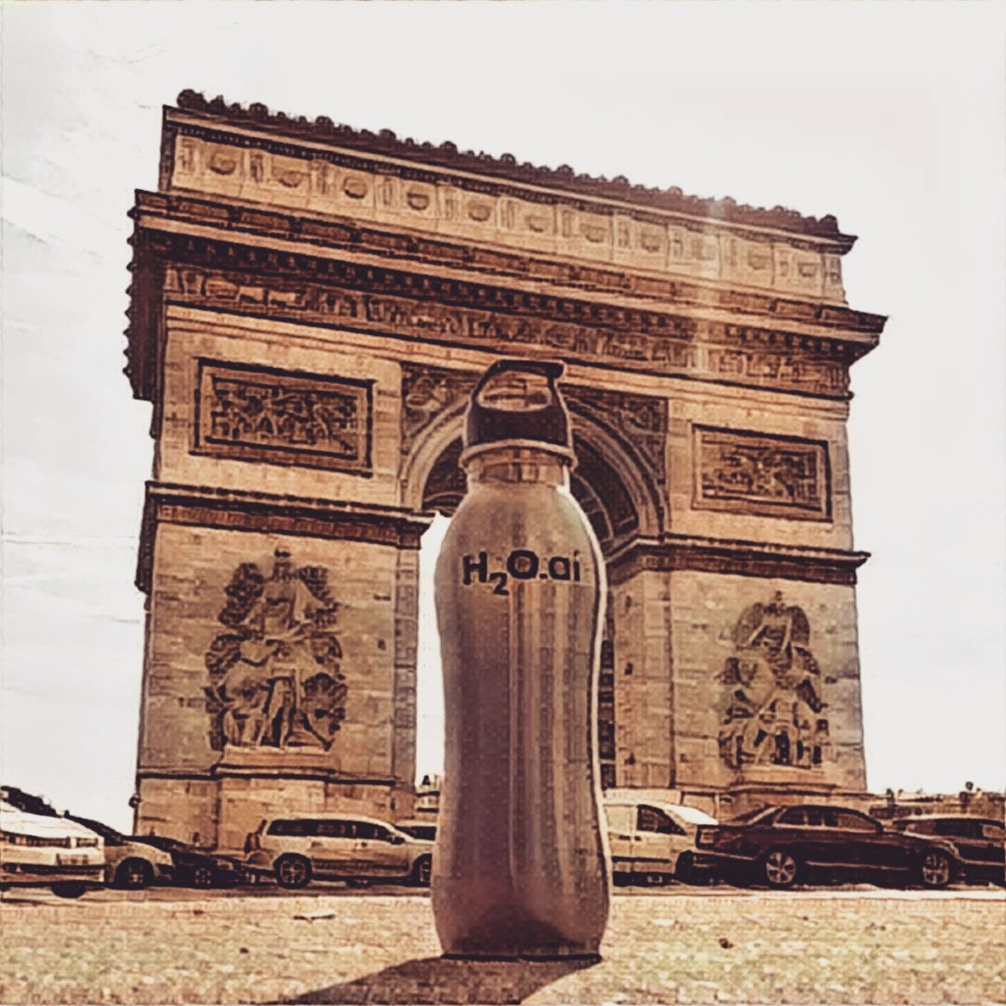
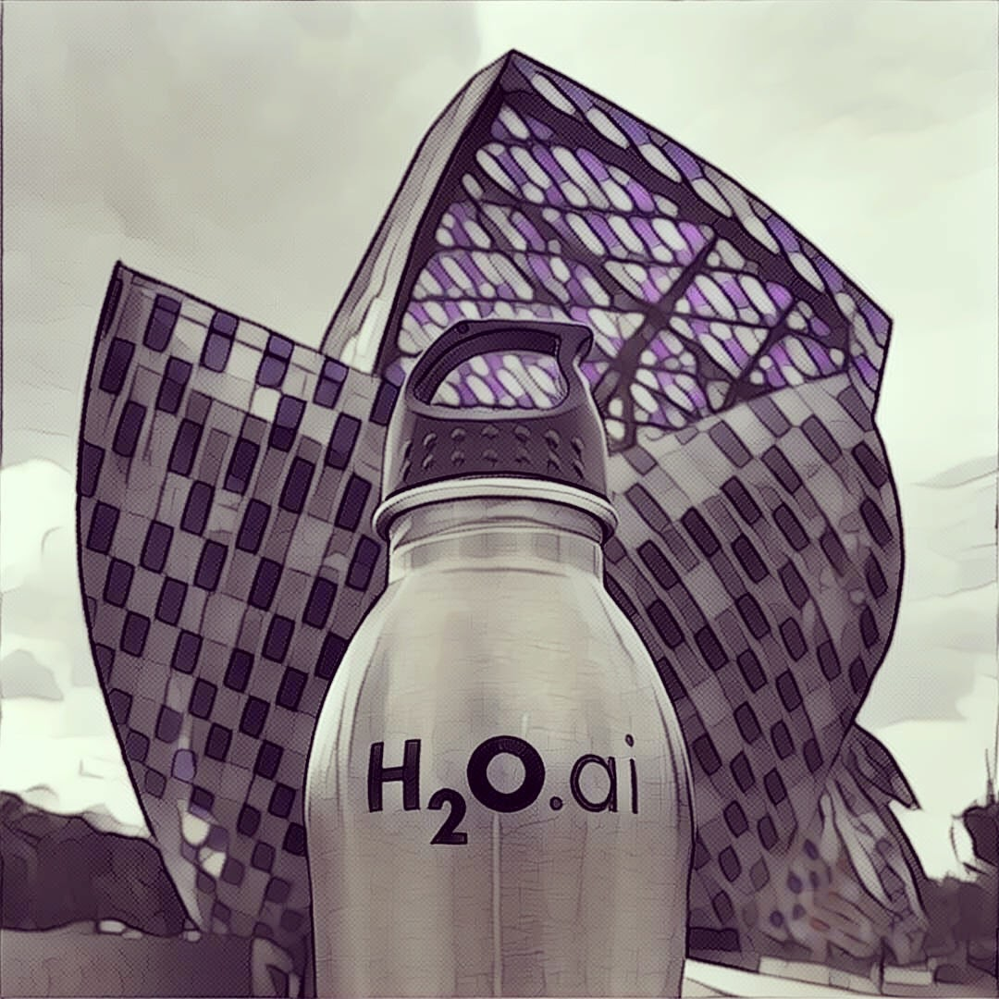
H2O Around the World
Paris Machine Learning Meetup (last week)

Slide 3
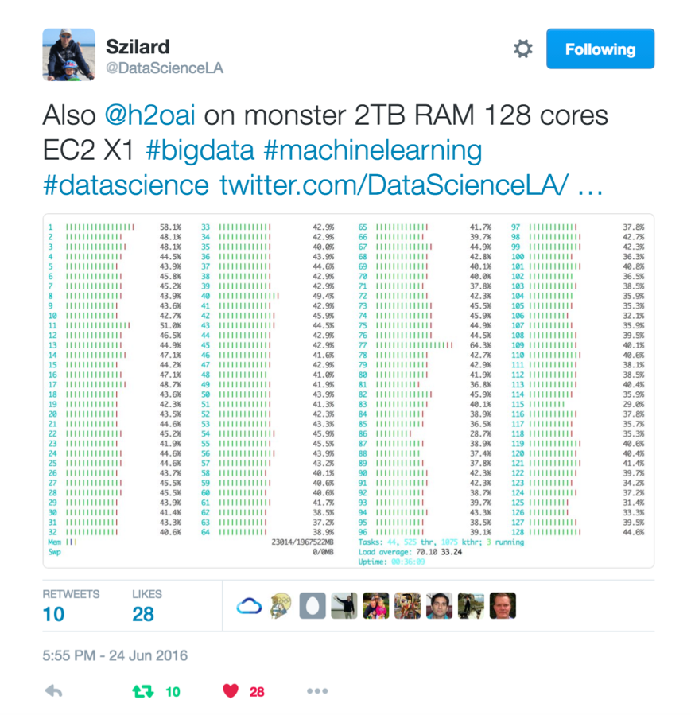
Szilard Pafka – ‎Chief Data Scientist at Epoch
Sziland’s talks / blog posts about H2O:
ML Benchmark
Intro to ML with H2O
H2O Scoring
Tweets

Slide 4
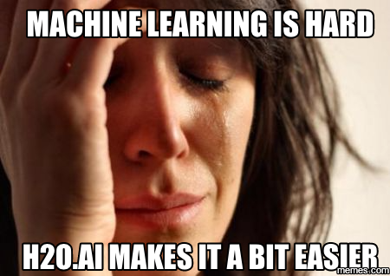
Szilard Pafka – Why H2O?
Szilard’s Summary Slide

Slide 5

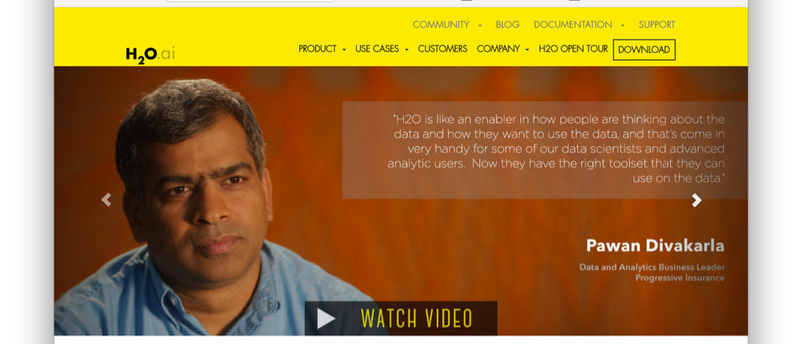
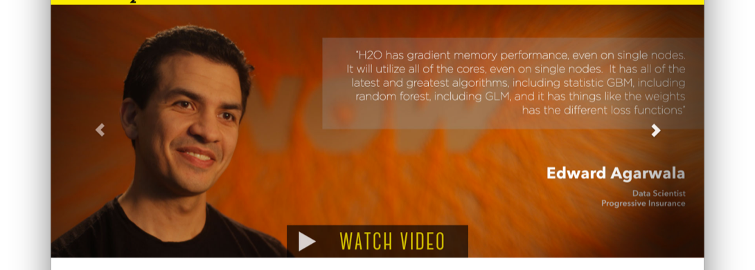
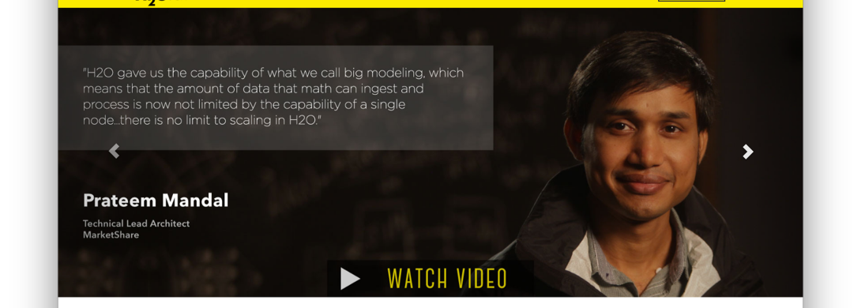
H2O Customers
Check out the videos - www.h2o.ai

Slide 6
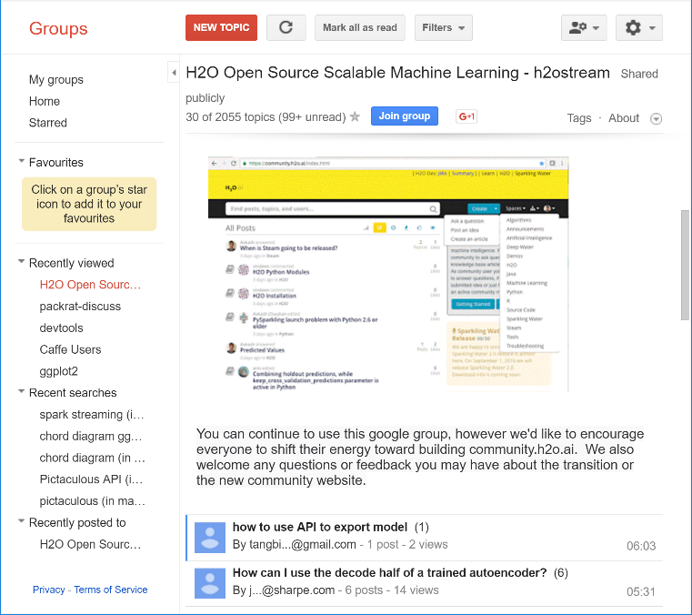
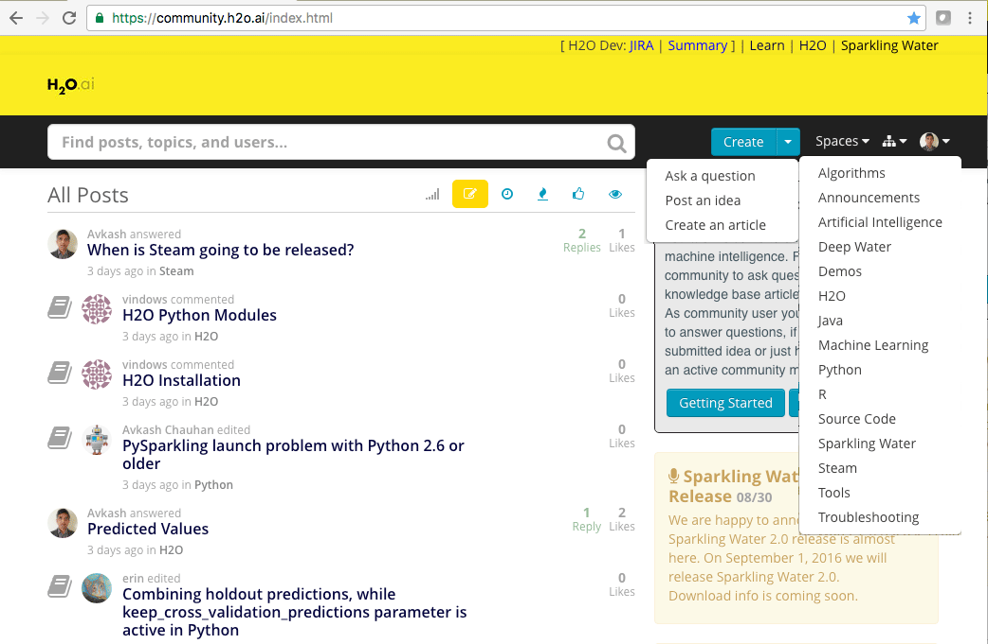
H2O Community Support
Google forum – h2osteam
community.h2o.ai

Slide 7
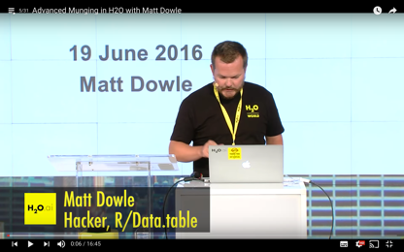
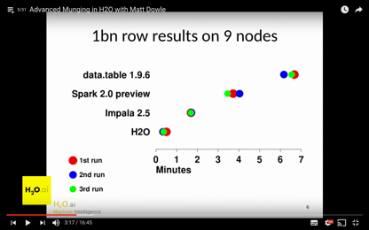
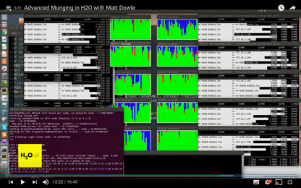
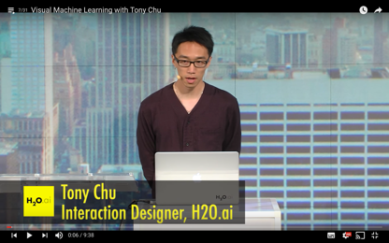
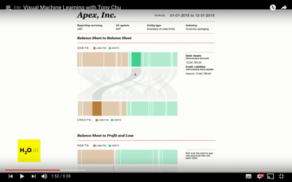
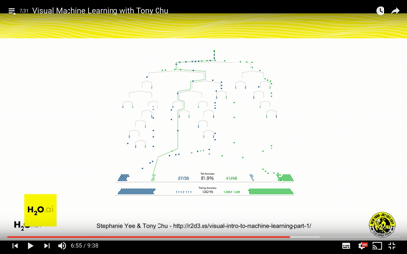
H2O is Evolving
H2O Open Tour NYC YouTube Playlist
Advanced data munging
Visual ML
Deep Water (2nd talk)
Sparkling Water (3rd talk)
Steam
New data science platform

Slide 8
Why Deep Water?

Slide 9
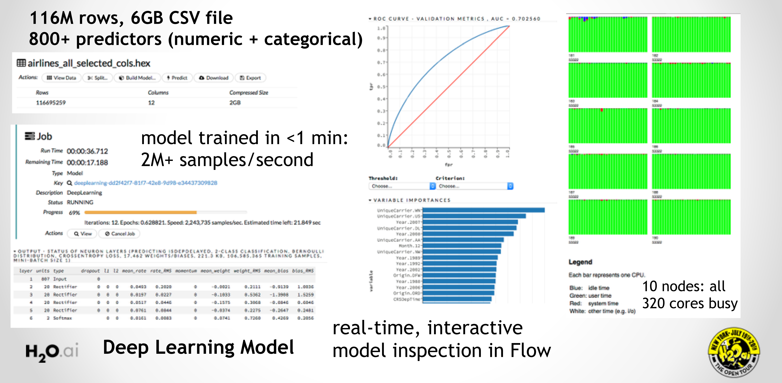
H2O Deep Learning in Action

Slide 10
H2O Deep Learning Community Quotes

Slide 11
H2O Deep Learning Community Quotes

Slide 12
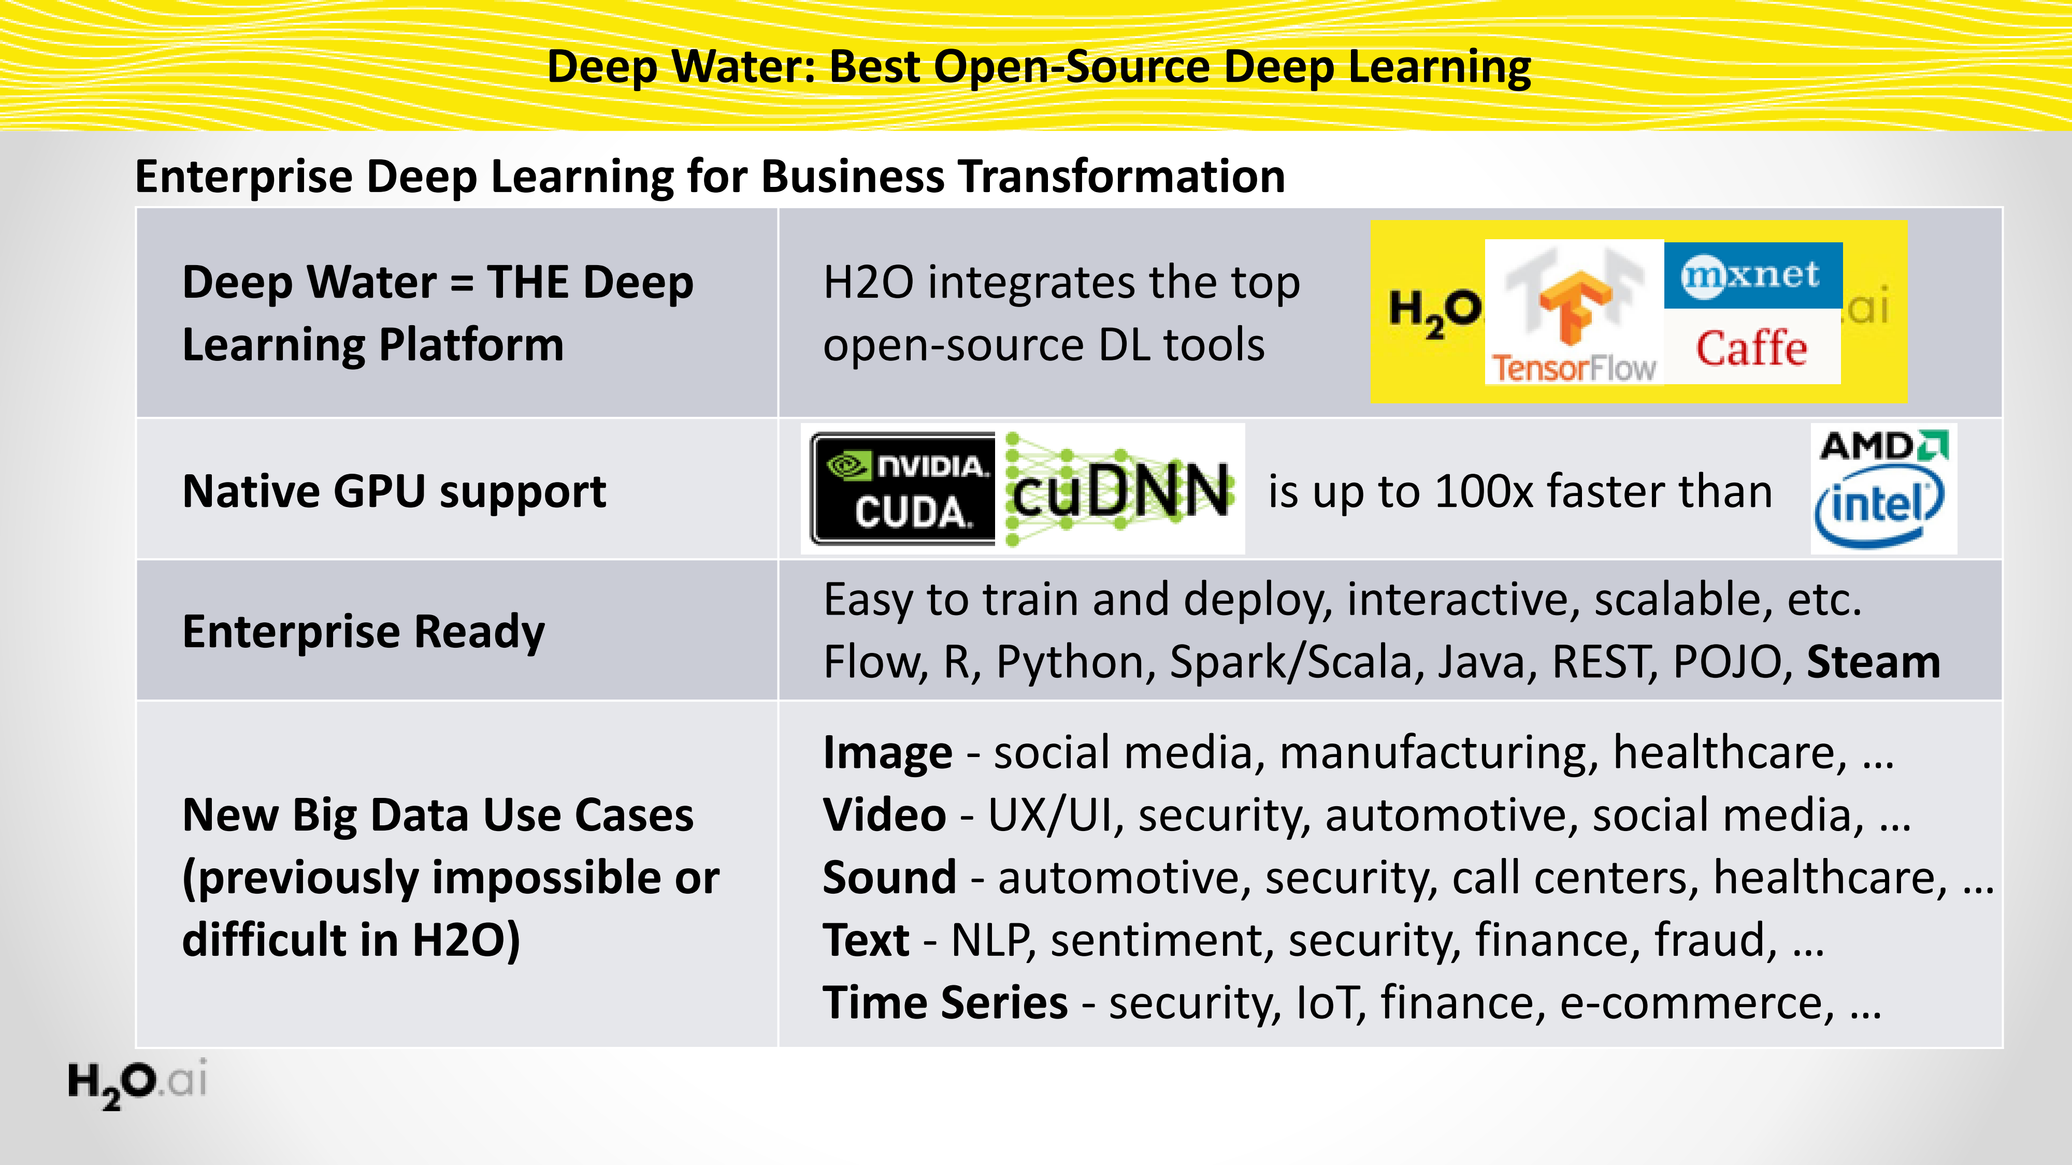
Deep Water: Next-Gen Deep Learning in H2O

Slide 13
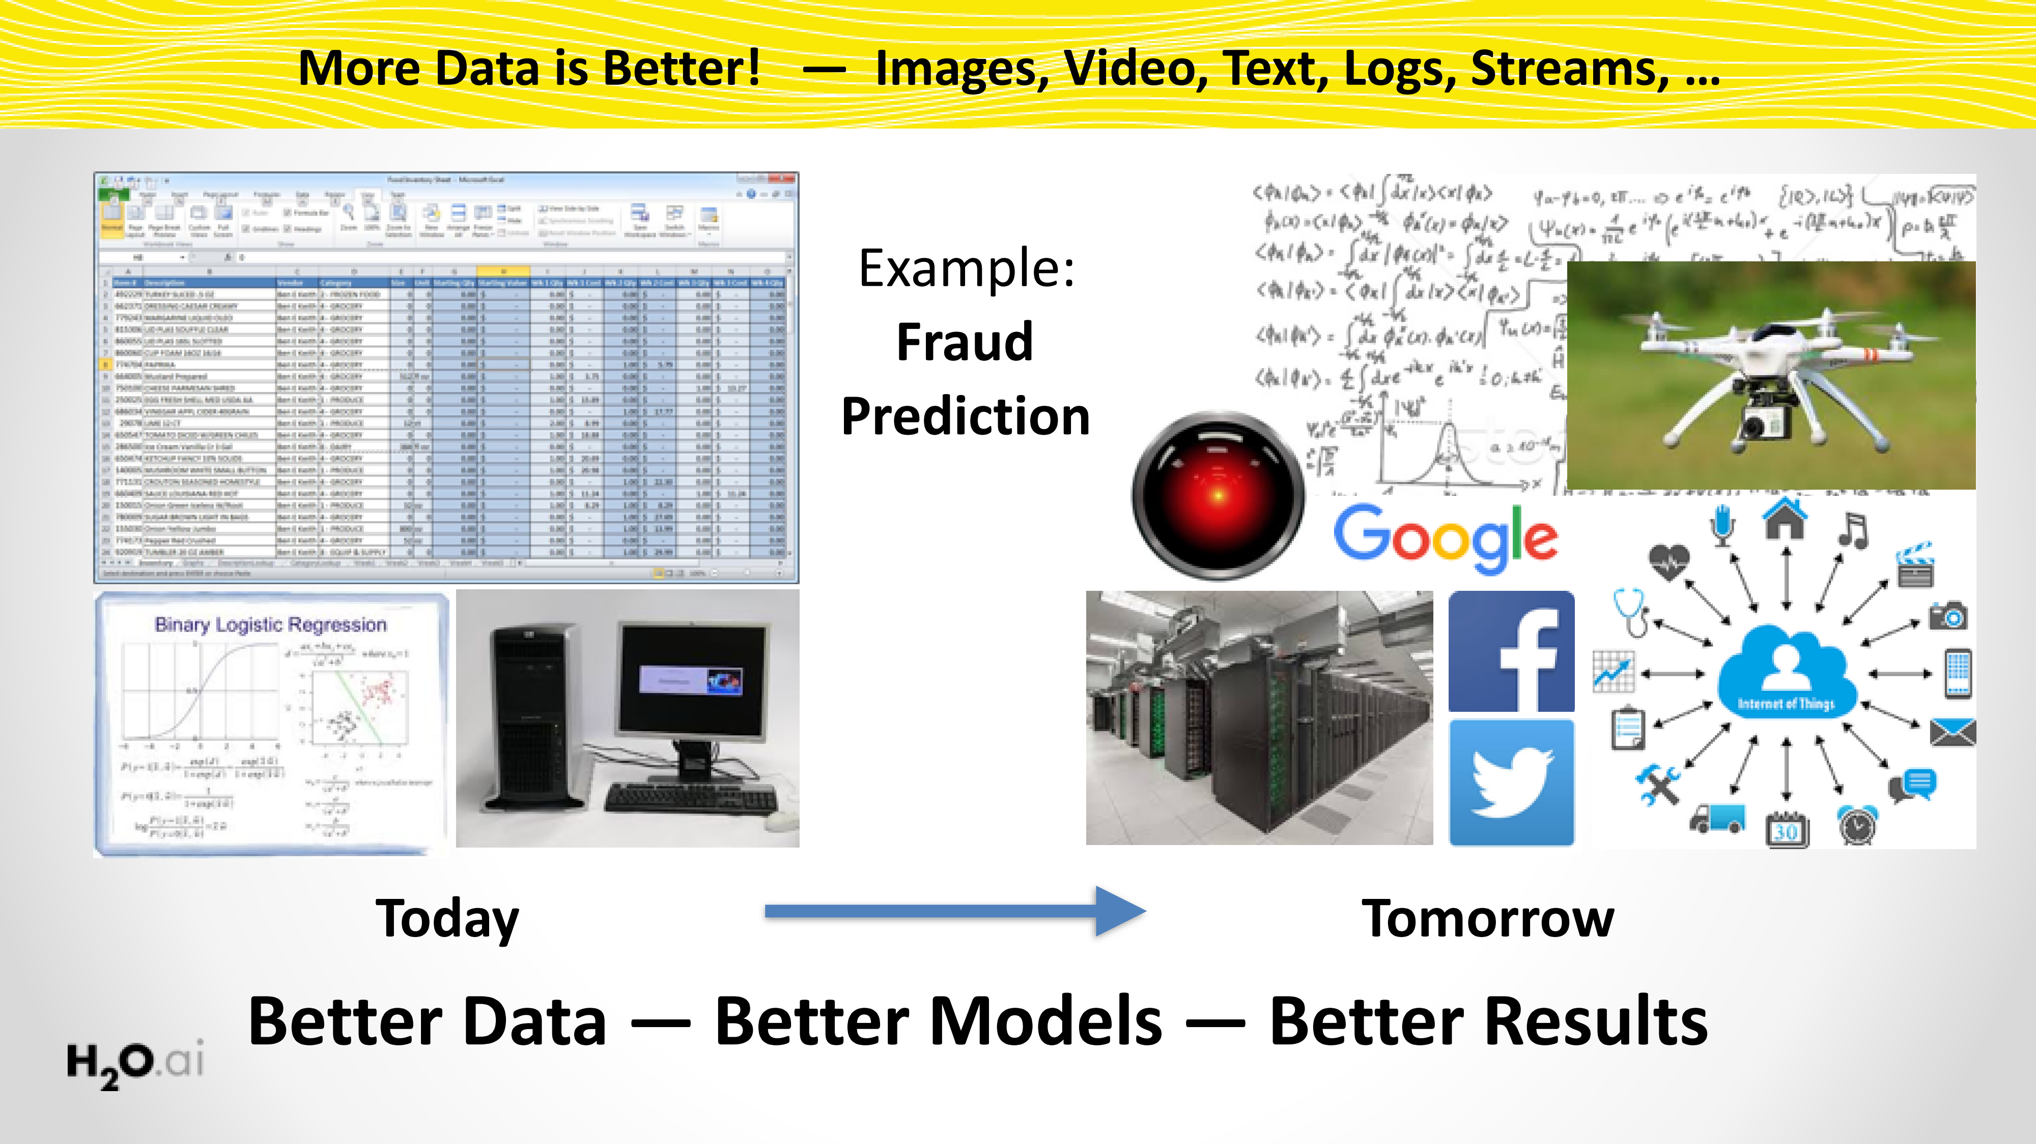
Deep Water opens the Floodgates for State-of-Art Deep Learning
13

Slide 14
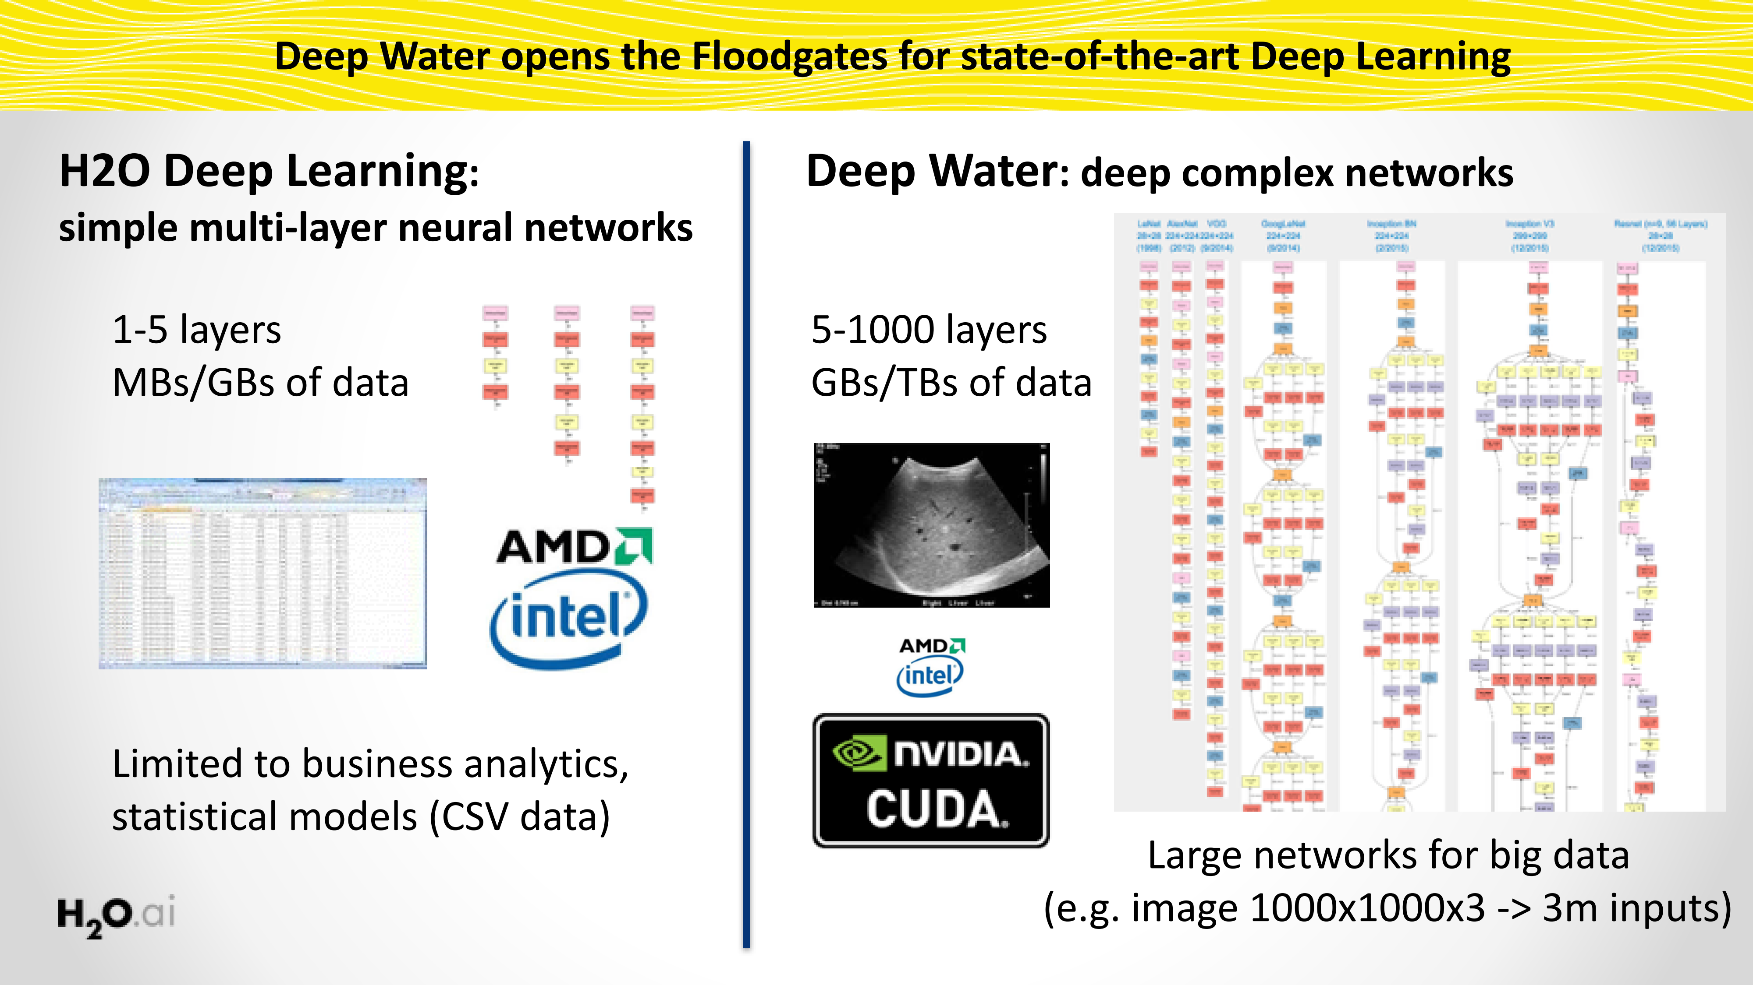
Deep Water opens the Floodgates for State-of-Art Deep Learning
14

Slide 15
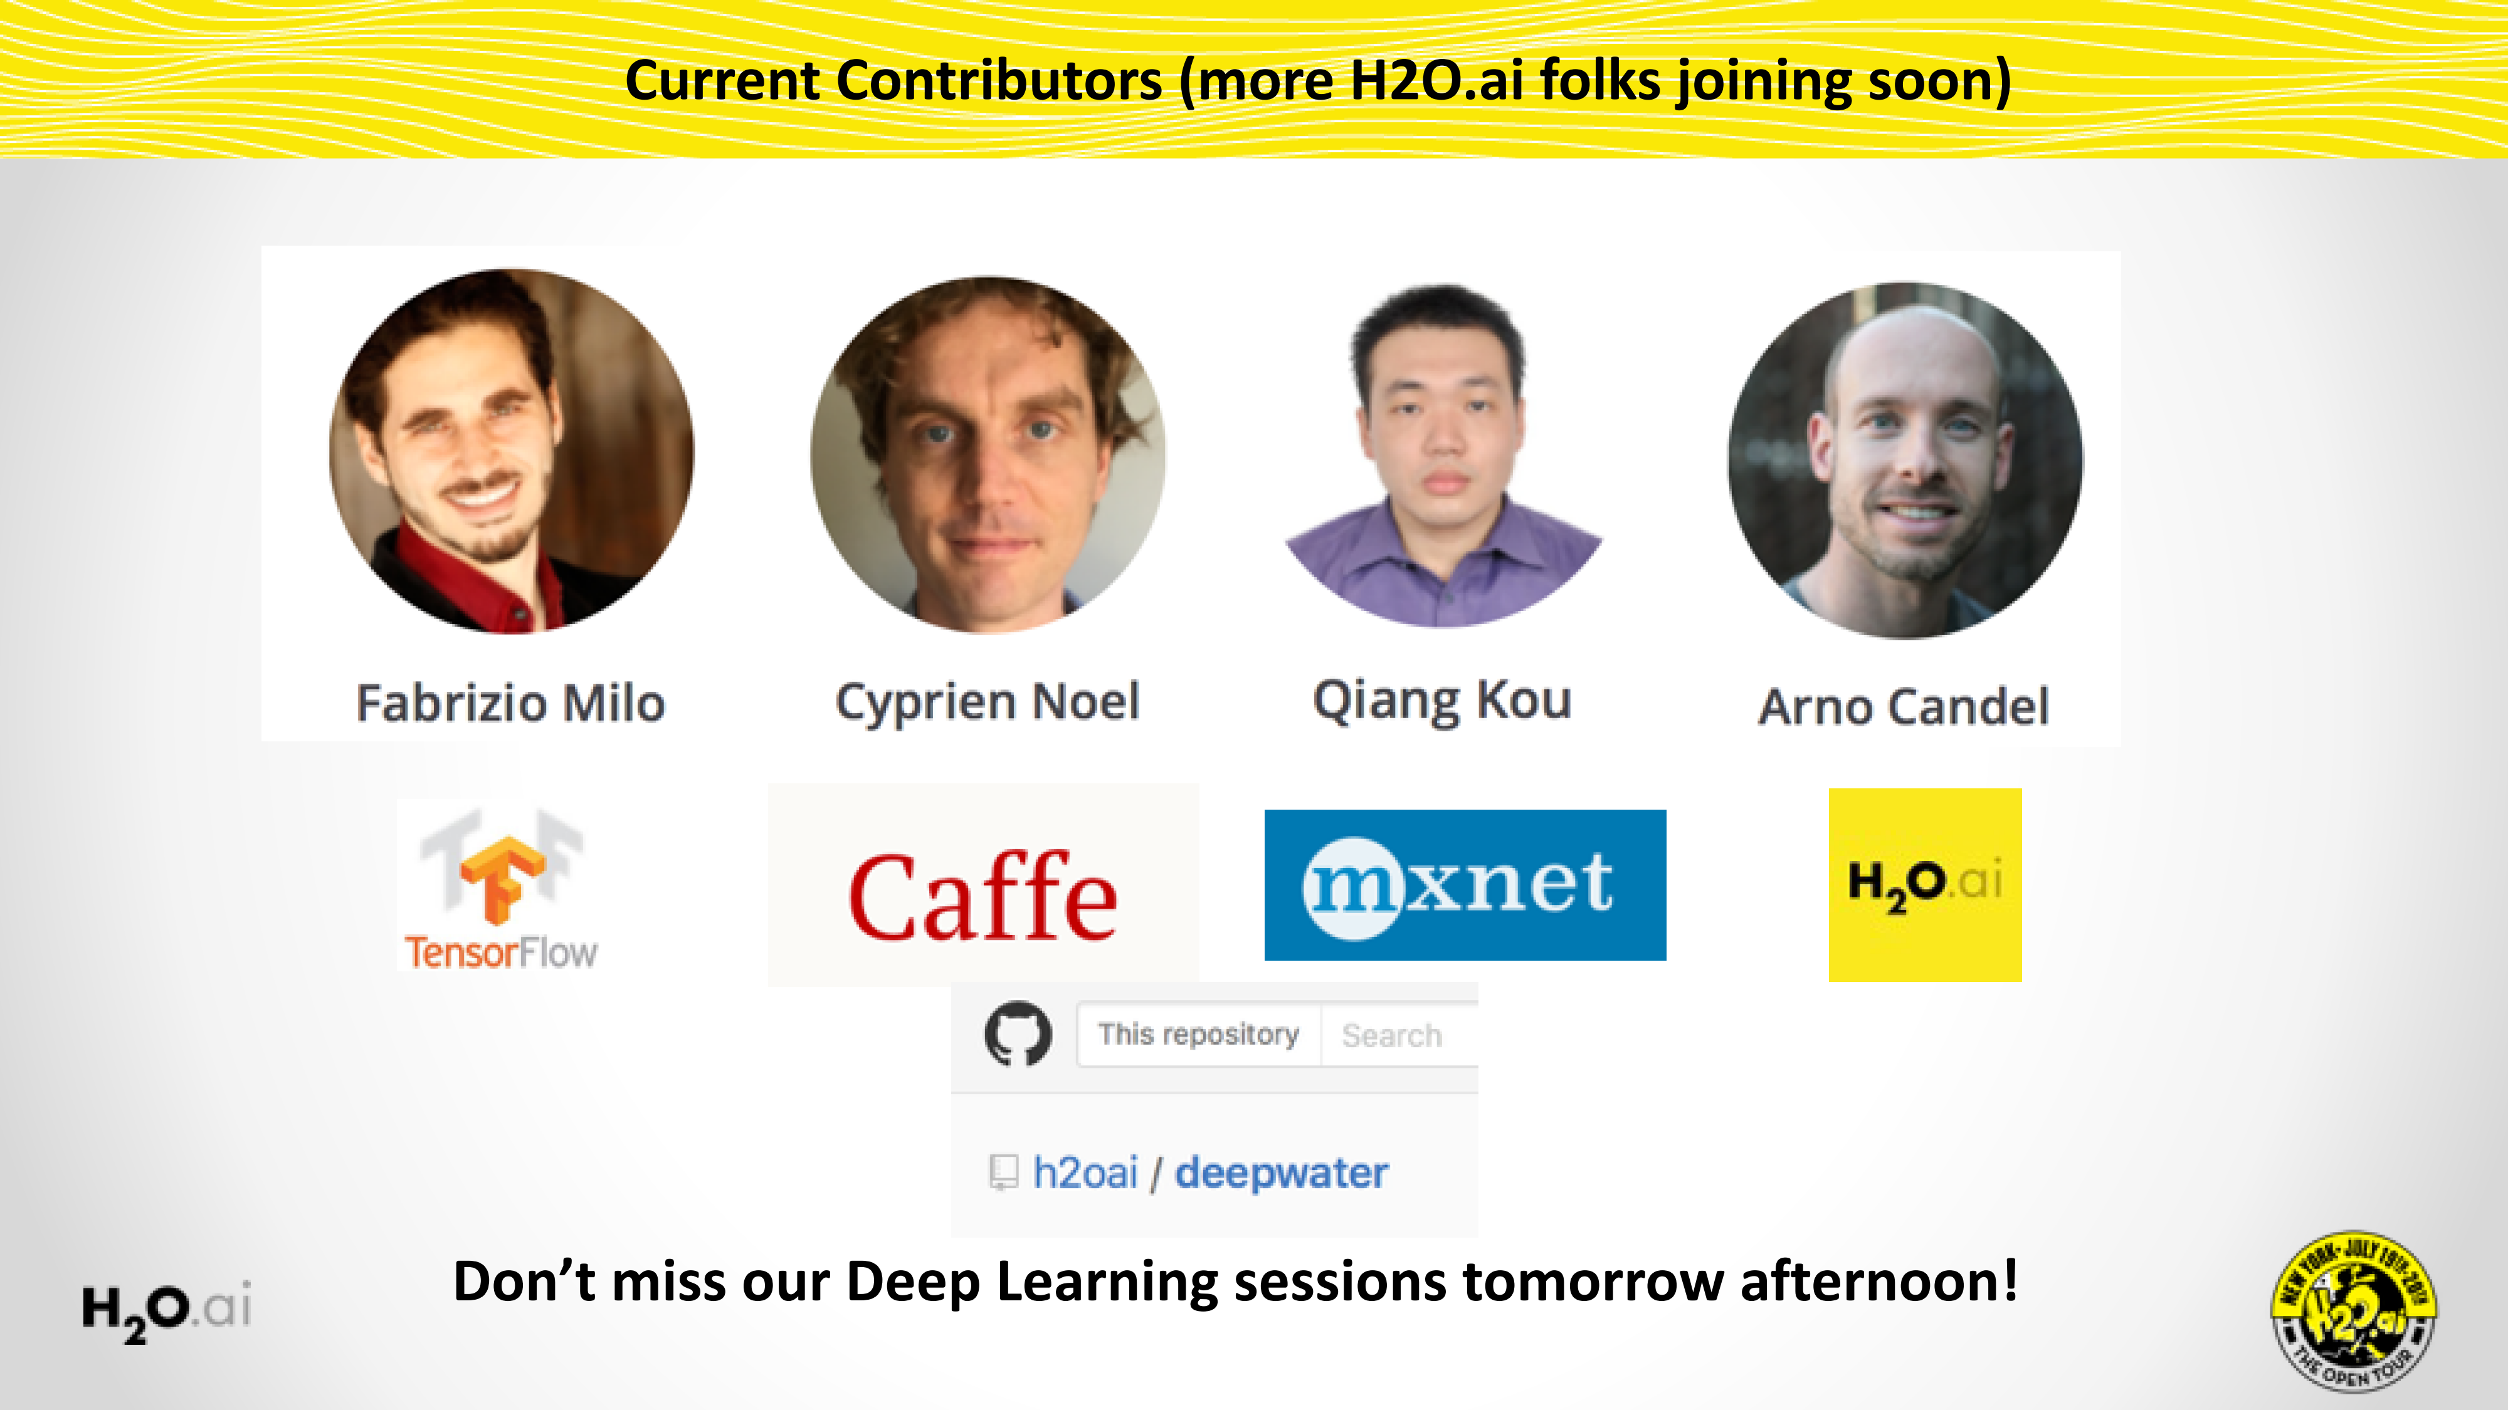
Deep Water opens the Floodgates for State-of-Art Deep Learning
15

Slide 16
Deep Water Demos
H2O + mxnet
Dataset:
Cat / Dog / Mouse
H2O Python interface
mxnet GPU backend
Train a LeNet (CNN) model
Explore model in Flow
H2O + TensorFlow
Dataset:
MNIST hand-written digits
Sparkling Water + Jupyter Notebook
Convert TensorFlow model into H2O
Explore models in Flow

Slide 17
For Online Audience
H2O + mxnet
bit.ly/h2o_paris_1
demo_03_mxnet
H2O + TensorFlow
bit.ly/h2o_paris_1
demo_04_tensorflow

